Slide 1
Introduction To Kotlin

Slide 2
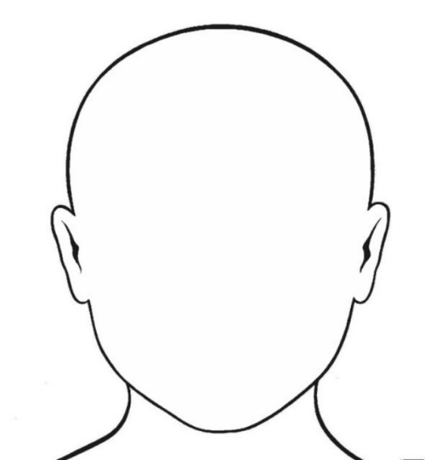
Introduction
Bartek Kuczyński
Bkuczynski@luxoft.com
http://luxoft-training.pl
http://luxoft-training.com

Slide 3
Training Roadmap: OVERVIEW
Motivation
Basic elements
Classes and Interfaces
Functions
Data Classes
Operators
Extensions
This training covers major aspects of Kotlin language. The goal of this training is to recognize basic concepts and .
This training is targeted to java developers who would like to start to learn other language on JVM platform.
Pre-requisites:
Git client
Gradle 2+
Your favorite IDE

Slide 4
TRAINING ROADMAP: STRUCTURE
2 x 1h sessions
One short break
We start after lunch
Short presentation
Exercise

Slide 5
Motivation: Why we need Kotlin && some history

Slide 6
What is Kotilin?
Vilage in Poland
Municipality
Known because there are food factory
Island near St. Petersburg
City of Kronsztad – HQ of Russian Baltic Fleet
JVM Language stable release at march 2016

Slide 7
Why we need another JVM language?
Andrey Breslav Kotlin project lead:
Kotlin were designed to make developer happier
Focus on flexible abstraction for code reuse and readability
Designed for industry and by industry
Easy to learn – easy to adopt
http://zeroturnaround.com/rebellabs/jvm-languages-report-extended-interview-with-kotlin-creator-andrey-breslav/

Slide 8
Use cases
Big java code base
Android application written in Java 1.6
JavaScript as target platform

Slide 9
Basic Elements : Variables, loops, etc

Slide 10
Traditional: Hello World
fun main(args: Array<String>) { println("hello world!") }
fun main(args: Array<String>) { val max: Int = 10 val start = 0 val txt = "some" var name = "" }

Slide 11
Loops: do while
fun main(args: Array<String>) { val max: Int = 10 val txt = "some" var name = "" do { name += txt } while (name.length < max) println(name) }

Slide 12
Loops: For
fun main(args: Array<String>) { val max: Int = 10 val start = 0 val txt = "some" for(i in start..max){ println("$i") } }

Slide 13
Slide Title: Subtitle

Slide 14
Slide Title: Subtitle

Slide 15
Slide Title: Subtitle

Slide 16
Color Gamma

